Slide 1
XSL Stylesheets
Comp4711
#7 – Feb 17/09

Slide 2
XSL Stylesheets
XSL...
Stylesheets
Transforming
XSL Internals
Filtering & Sorting
Templates

Slide 3
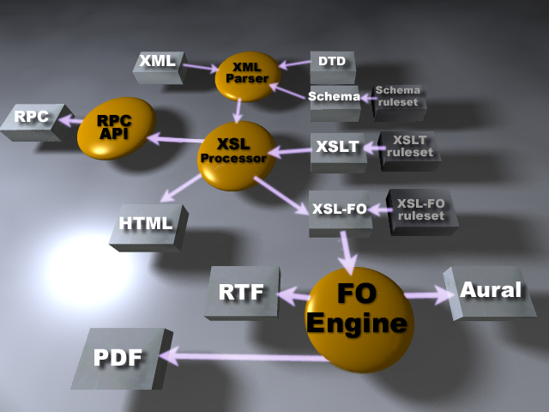

Slide 4
1. Intro to XSL
XSL can:
  transform XML to HTML, PDF, etc.
  filter/sort XML data
  address parts of an XML document
  format XML data based on the data value
  output XML to different devices

Slide 5
Languages
XSL has 3 sub-components to it:
  XSLT to transform XML (transforming)‏
    Transforms XML into other types of documents (or other XML documents)‏
  XPath define XML parts or patterns (defining)‏
    Addresses parts of an XML document
    Designed to be used by XSLT
  XSL Formatting Objects define XML display (formatting)‏

Slide 6
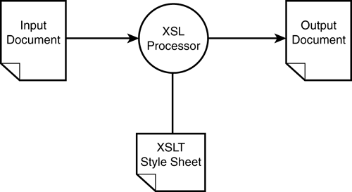
XSLT
T is for Transformations

Slide 7
2. What Are Style Sheets
Describe how documents are presented for:
  Computer screen, printer, displayed on a cell phone, pronounced
Separate presentation from content
Define presentation rules once & reuse
  One external ‘style page’ referenced
  Many content pages use the style page

Slide 8
Advantages
Visual consistency
  layout, font, headings, color, paragraph
Save on bandwidth & reload time of data
Follows the client server model
Can limit access of style to designers only

Slide 9
3. Transforming (1/2)‏
Most important part of XSL standard
Does transformations
Uses XSLT
XSLT is an XML based markup language
Example of XSLT transforming XML to HTML:
  Each XML element = 1 HTML element
  Can also:
    create completely new elements
    remove elements
    rearrange & sort elements
    test & make decisions about which elements to display

Slide 10
Transforming (2/2)‏
Simple description:
  XSL uses XSLT to transform an XML source tree to an XML result tree
Process:
  XSLT uses XPATH to define parts of the source document
  Do the parts match 1 or more predefined templates?
  Transform matching part of source doc into result doc
  Anything left over is not transformed

Slide 11
XSLT Processors
A software component that implements the XSLT standard.
There are several XSLT processors on the market
  Microsoft (www.microsoft.com),
  Oracle (www.oracle.com), and
  Apache (xml.apache.org).
  James Clark, the editor of the XSLT standard, (www.jclark.com and www.4xt.org).

Slide 12
XSLT Processors
Xalan: an open-source -- Apache foundation.
  originally developed by Lotus/IBM
  later donated to the Apache Foundation.
  Like most XML tools, Xalan is written in Java.
Xalan comes with a command-line interface
  but a graphical user interface is wrapped around it.
  Can download from www.marchal.com or www.mcp.com.

Slide 13
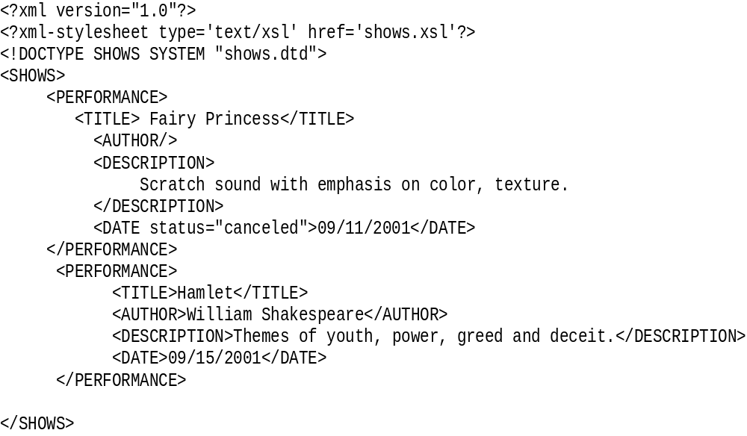
XML Document
Where to find it
Type of Stylesheet

Slide 14
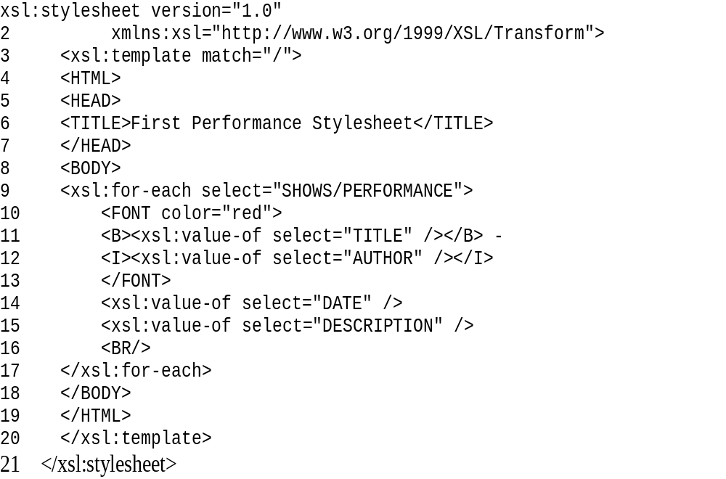
XSL Document

Slide 15
4. Root Element
xsl:stylesheet is always the first Element
<xsl:stylesheet version="1.0" 2 xmlns:xsl="http://www.w3.org/1999/XSL/Transform">
Root Element spans two lines
Note the attribute: xmlns:xsl
xsl is a namespace

Slide 16
Select Element to format
<xsl:template match="/">
namespace
The “/” is the root element so entire document is transformed
template tag
Attribute “match” tells the XSL stylesheet which elements of the XML document to format or transform.

Slide 17
Some HTML
<<HTML>
<HEAD><TITLE>First Performance Stylesheet</TITLE></HEAD>
<BODY>
…
This HTML will be output to the browser
Start Body

Slide 18
XSL:for-each select attribute
<xsl:for-each select="SHOWS/PERFORMANCE">
Attribute value is Element to select
for-each-select attribute like simple for statement

Slide 19
XSL:value-of select attribute
<xsl:for-each select="SHOWS/PERFORMANCE">
<FONT color="red">
<B><xsl:value-of select="TITLE" /></B> -
<I><xsl:value-of select="AUTHOR" /></I>
</FONT>
<xsl:value-of select="DATE" />
<xsl:value-of select="DESCRIPTION" />
<BR/>
</xsl:for-each>
Formatting / Style
Display the value of this Element
Select the value of the given Element

Slide 20
Transformed Document - HTML
<HTML>
<HEAD> <TITLE>First Performance Stylesheet</TITLE>
</HEAD>
<BODY>
<FONT color="red">
<B>Fairy Princess</B> - <I></I>
</FONT>
09/11/2001
Scratch sound with emphasis on color, texture.
</BODY>
</HTML>
Data replaces xsl tags

Slide 21
New Example
Look at the files cdcatalog.xml and cdcatalog.xsl
Look at the output
Goes through all of the cd nodes in the catalog node and outputs the value of the title and the artist nodes
Example #1

Slide 22
5. Filtering the Output
Legal filter operators are:
  = (equal)
  != (not equal)
  &lt; less than
  &gt; greater than

Slide 23
Example of Filtering
Modify the for-each line to look like:
<xsl:for-each select="catalog/cd[artist='Bob Dylan']">
Add this line to the cdcatalog.xsl file
Example #2

Slide 24
Sorting the Output
Add an <xsl:sort> element inside the <xsl:for-each> element in the XSL file
Add the line:
<xsl:sort select="artist"/>
To the example file
Example #3

Slide 25
Conditionals
Add an <xsl:if> element to the XSL document.
Syntax
<xsl:if test="expression">
...some output if the expression is true...
</xsl:if>
Add the lines:
<xsl:if test="price &gt; 10">
</xsl:if>
To the cdcatalog.xsl file
Example #4

Slide 26
Multiple Choices
The choose element in conjunction with the when and otherwise elements can be used to do multiple tests
Syntax:
<xsl:choose>
<xsl:when test="expression">
... some output ...
</xsl:when>
<xsl:otherwise>
... some output ....
</xsl:otherwise>
</xsl:choose>
Example #5

Slide 27
6. Templates
Finds nodes in the source document
So far we’ve seen:
<xsl:template match=“/”>
Specifies starting at root
Could also do:
<xsl:template match=“/customers”>
Specifies starting at the customers element off the root

Slide 28
Output
Select attribute of the <xsl:value-of> element
Used to output values to the target
<xsl:value-of select="catalog/cd/title"/>
Important to realize that nothing else is written to the target

Slide 29
Applying Templates
The <xsl:apply-templates> element applies a template to the current element or to the current element's child nodes
If we add a select attribute to the <xsl:apply-templates> element it will process only the child element that matches the value of the attribute.
We can use the select attribute to specify the order in which the child nodes are processed
Example #6

Slide 30
Transforming Using Javascript
Do browser-specific testing
Use different style sheets according to browser and user needs
Especially important for portable devices
The power of client side processing
Javascript Example

